Slide 1

Housing Production Plan:
Meeting Local Needs
January 21, 2015

Slide 2
What is a Housing Production Plan?
Outlines a path for compliance with Chapter 40B.
Reflects local context and land use goals
Offers protection from unfriendly Comprehensive Permits if new affordable units are created or the town implements zoning to enable affordable housing construction
Identifies Medfield’s housing needs.
Based on demographics, housing market conditions
Considers housing issues affecting Medfield residents and neighborhoods.
Affordable Housing Income Guidelines (FY 2013)
Household size: | 1 person | 2 person | 3 person | 4 person | 5 person | 6 person
80% AMI | $47,150 | $53,900 | $60,650 | $67,350 | $72,750 | $75,150
50% AMI | $33,050 | $37,800 | $42,500 | $47,200 | $51,000 | $54,800
Notes:
Median income for FY2013 was $94,400

Slide 3
Market Context: Homes in Medfield
Median size: owner-occupied have 8.2 rooms; renter-occupied 3.4 rooms
Average assessed value in 2013 was $563,000; average tax bill $8,859
Average of 20 new units per year; no multifamily built from 2002-2011
Notes:
Median sales price of condos was $200,000

Slide 4
Demographic Context: Medfield Residents
Stable or negative population growth.
Prevalence of families with children.
Fewer households with elderly members.
Total Population | 12,273
5-18 years | 3,157
65-74 years | 736
75 and over | 636
Total Households | 3,954
Married Couple Families with Children | 1,631
Non-married Families | 398
People Living Alone | 698
Households with Seniors | 845
Notes:
Comparison with neighboring communities: Dover Sherborn, Millis, Norfolk, and Walpole. Most similar in size to Norfolk. Dover and Sherborn, although smaller, have similar socio-economic profiles.
Medfield lost 2% of its population between 2000 and 2010.
The majority of Medfield’s households are families: around 70 percent. About half of Medfield’s families have children. Largest average family size in the region, at 3.31
Families which do not include married couples – about half have children under age 18.
21 percent of households have members over the age of 65 – lowest in the region except for Norfolk.

Slide 5
Income and Homeownership
Median Income | All Households | Families | Married Families with Children | Non-Families | Households headed by seniors
Medfield | $126,048 | $145,060 | $170,000 | $40,368 | $48,646
Norfolk County | $81,027 | $101,870 | $128,126 | $44,947 | $40,676
Medfield
Homeownership | 90.5% | 96.4% | 100.0% | 66.4% | 89.7%
Rental Occupancy | 90.5% | 3.6% | 0.0% | 33.6% | 10.3%
Income closely corresponds with household type.
Majority of rental housing is occupied by nonfamily households.
Notes:
While 70 percent of households are families, nonfamily households occupy 70 percent of rental housing units.

Slide 6
Housing Affordability
Low income homeowners - typically seniors - are most burdened with high housing cost.
Lower rates of cost burden for renters reflect Medfield’s existing subsidized housing.
Households Spending More than 30% of Income on Housing
 | Income <$35,000 | Income $35,000-$49,999 | Income $50,000-$74,999 | Income >$75,000 | Total Cost-Burdened Households
Homeowners | 86% | 72% | 59% | 20% | 1,100
Renters | 78% | 18% | 0% | 29% | 144

Slide 7
Housing Needs / Chapter 40B Gap
Medfield residents need more diverse housing options.
Seniors, young adults, individuals living alone,
empty nesters
Apartments (small and large)
Less expensive homes or condos for downsizing or starting out
Medfield has reached 6.7% of its units on DHCD’s SHI.
286 affordable units in 5 developments.
10% goal of 2010 year round housing units 422.
136 additional units needed.
New market rate development will raise the bar in 2020.
Notes:
In addition to 5 developments there are 8 group homes (included in 286). Parc also included in 5 sites.
4,220 housing units in 2010

Slide 8
Recommendations
Develop local capacity to plan and advocate for, as well as to develop and manage affordable units.
  Increase technical capacity
  Educate/communicate with public
  Establish affordable housing trust
  Adopt CPA
  Explore potential partnerships with nonprofit developers

Slide 9
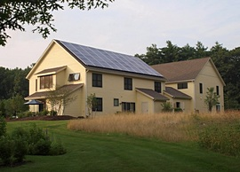
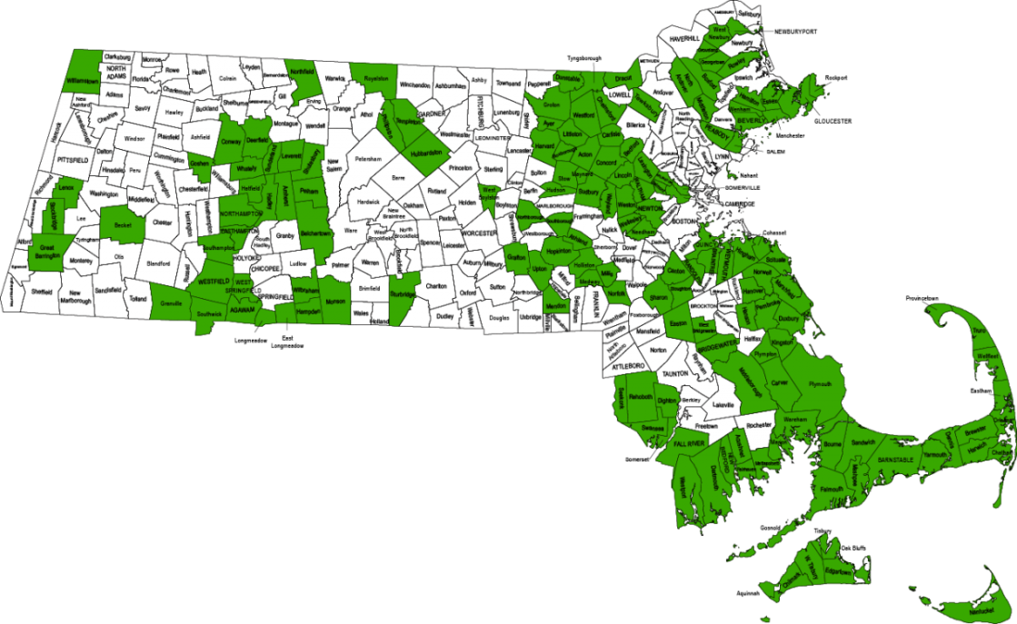
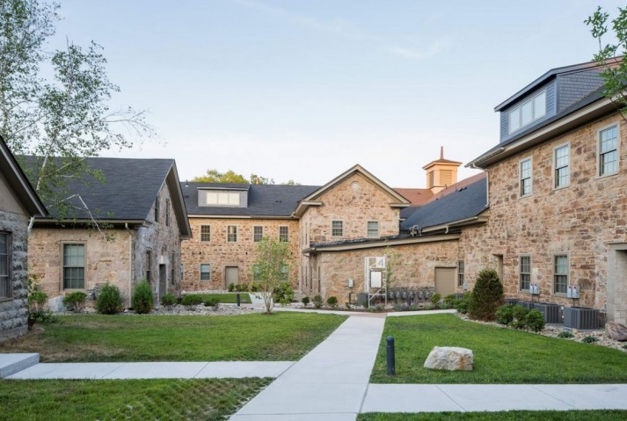
CPA Funding
10%-80% of CPA can be used for affordable housing
Can combine housing, historic preservation, open space objectives
Allowed to bond for large projects
5% administrative budget
Can be used to support moderate income housing (up to 100% AMI)
89 Oxbow, Wayland
Ames Shovel Works, Easton
Photo Source: HousingPolicy.org

Slide 10
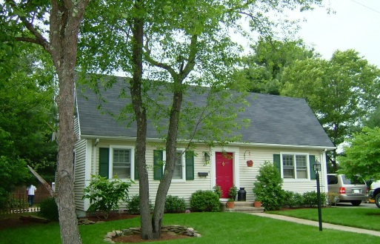
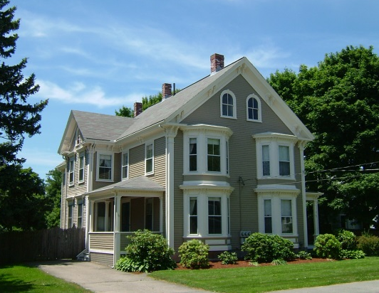
Sites for Affordable Housing
Identify sites for creation of affordable housing through new development, redevelopment, or preservation. Possible locations include:
Medfield State Hospital
Other Town-owned properties
Privately-owned properties
Scattered-site affordable housing strategies:
Convert existing homes to affordable homeownership units through Town funding
Small-scale LIP
Infill development or multifamily conversions
Can be combined with historic preservation and open space protection.
Notes:
Tilden Village has been suggested as a site that could accommodate about 20 units of senior housing next to the existing Medfield Housing Authority property.

Slide 11
Zoning Strategies
Update zoning to create opportunities for development of affordable housing, and to encourage diversity in housing options.
Zoning for Medfield State Hospital site
Inclusionary or Incentive Zoning
Accessory Dwelling Units/Multifamily conversions
“As of Right” mixed income housing districts:
Chapter 40R
Compact Neighborhoods
Notes:
Compact neighborhood:
Allow for minimum number of “future zoned units” = 1% of total year round housing – at least 42 units for Medfield
Allow 8 units per acre for multifamily (comparable density to Tilden Village), or 4 units per acre for single family (comparable to Allendale)
At least 10% of units affordable (in projects >12 units)
Age-restriction cannot apply to entire district, but may apply to part of it.
For Chapter 40R:
20 units per acre for multifamily
8 units per acre single family
20% affordable
Incentive funds up to $600,000 when zoning is adopted, plus $3,000 for every new housing unit

Slide 12
Addressing Housing Cost Barriers
        Provide support to first time homebuyers and elderly residents to overcome cost barriers.
        Update tax deferral program
        Offer first-time homebuyer assistance program
Notes:
Current limit for tax deferral program is $40,000. Consider raising the income limit to 80% of AMI.

Slide 13
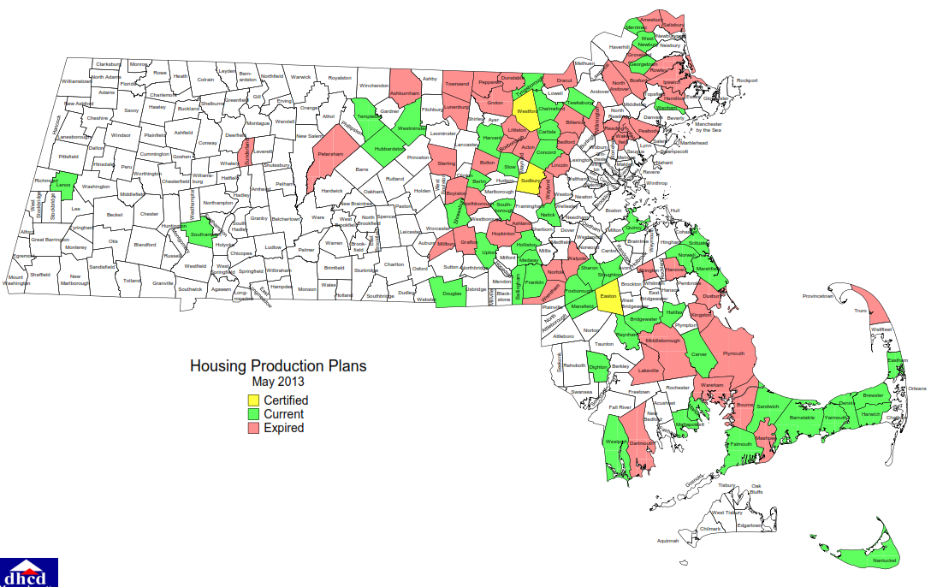
Next Steps:
Local boards adopt Housing Production Plan
Submit to DHCD for approval
Use HPP as a guide to identify appropriate locations
and types of housing that are preferred
Implement zoning or other initiatives to build capacity
and facilitate creation of affordable units
Attain “safe harbor” from 40B

Slide 14
Questions?

